Slide 1

How to Build a Better Board,
Starting Today
January 19, 2022
Judy Siegel, Senior Staff Attorney

Slide 2
PLEASE NOTE
Not Legal Advice
This presentation is provided as a general informational service to clients and friends of Pro Bono Partnership. It should not be construed as, and does not constitute, legal advice on any specific matter, nor does this presentation create an attorney-client relationship. You should seek advice based on your particular circumstances from an independent legal advisor.

Slide 3
Fair Use Act Disclaimer
RE: Copyright
This presentation may contain copyrighted material which has not been specifically authorized by the copyright owner. The Pro Bono Partnership is a nonprofit 501(c)(3) exempt organization that is making this material available for educational purposes only. As such the Partnership believes this constitutes “fair use” of any such copyrighted material as provided for in Title 17 U.S.C. § 17 (The Copyright Act of 1976).

Slide 4
Pro Bono Partnership

Slide 5
Brief Overview of Pro Bono Partnership
Our mission:
  strengthen nonprofits and communities
  free legal services
  Provide a mechanism for transactional lawyers to volunteer in their area of expertise
Our clients:
  serve the disadvantaged
  enhance the quality of life
  unable to pay
  NY, NJ, CT
Our volunteers
  Practice in their field of expertise
  choose their projects

Slide 6
Types of Pro Bono Partnership Clients

Slide 7
What Assistance is Avaialble
Intellectual property
Lending/finance
Merger/collaboration
Real estate
Tax
Trusts and estates
Compliance
Contracts
Corporate structure/governance
Dissolution and bankruptcy
Employment/volunteer issues
Fundraising/charitable solicitation laws
Incorporation/tax exemption

Slide 8
General Overview of
Today’s Topics

Slide 9
Today’s Agenda
Brief Overview of Board Roles and Responsibilities
Identifying Board Deficiencies
DEI as a Lens for Building a Board
Filling Open Positions
Engaging and Retaining New Board Members

Slide 10
Overview of the
Board’s Role

Slide 11
Fiduciary Duties of Directors

Slide 12
Why Do Nonprofits Have Boards?
Effective Governance
Legal Compliance and Public Disclosure
Strong Financial Oversight
Responsible Fundraising
Stewards of the nonprofit’s assets
Serve as risk managers
Hire/evaluate senior staff and professionals
Be visionaries: plan for the future

Slide 13
A Director of a Tax-Exempt Organization Is …
“a fiduciary of the organization’s resources and a facilitator of its mission”
Bruce R. Hopkins
The Law of Tax Exempt Organizations
11th ed. 2016

Slide 14
Fiduciary Duties of Nonprofit Directors
What is a “fiduciary”?

Slide 15
3 Fiduciary Duties of Nonprofit Directors
Duty of
Care
Duty of
Loyalty
Duty of Obedience

Slide 16
General Standard of Conduct
Generally a prudent person standard
  Expected to use the same degree of diligence, care, and skill
  which ordinary, prudent persons would exercise
  under similar circumstances in like positions.

Slide 17
Fiduciary Duties of Nonprofit Directors
Duty of Care:
directors are to act in a reasonable and informed manner when participating in decisions and exercising oversight of corporation
Guidebook for Directors of Nonprofit Corporations, Nonprofit Organizations Committee, ABA (3rd Ed., 2012), Chapter 2: “Duties and Rights of Nonprofit Corporation Directors”

Slide 18
Duty of Care
Literally “take care” of the organization; that is, devote attention to trustee’s/director’s tasks:
  Actively participate
  Provide strategic direction
  Manage or oversee management
  Require sufficient information to make sound judgments
  Ask questions when necessary

Slide 19
Fiduciary Duties of Nonprofit Directors
Duty of Loyalty:
directors are to exercise powers in good faith and best interests of corporation rather than their own interests or interests of another person or entity
Guidebook for Directors of Nonprofit Corporations, Nonprofit Organizations Committee, ABA (3rd Ed., 2012), Chapter 2: “Duties and Rights of Nonprofit Corporation Directors”

Slide 20

Fiduciary Duties of Nonprofit Directors
Duty of Loyalty:
Conflicts of Interest
Confidentiality
Transparency
Responsibility to Act

Slide 21
Fiduciary Duties of Nonprofit Directors
Duty of Obedience:
Duty of obedience means that board directors must make sure that the nonprofit is abiding by all applicable laws and regulations and doesn’t engage in illegal or unauthorized activities.
Board Effect, Fiduciary Duty, https://www.boardeffect.com/blog/fiduciary-responsibilities-nonprofit-board-directors/#:~:text=Duty%20of%20obedience%20mea
Guidebook for Directors of Nonprofit Corporations, Nonprofit Organizations Committee, ABA (3rd Ed., 2012), Chapter 2: “Duties and Rights of Nonprofit Corporation Directors”

Slide 22
Identifying Board Deficiencies

Slide 23
Who Do You Have and What Are You Missing
Skills
Contacts
Representation

Slide 24
Skills
Legal
Marketing
Social Media
Finance
Accounting
Nonprofit
Governance
Mission-related Knowledge
Fundraising
Notes:
.

Slide 25
Contacts
People who might be invested in your mission
People with mission-related expertise
Funders
Government administrators

Slide 26
The Business Case for Diversity
In 2019, top-quartile companies in ethnic and cultural diversity outperformed those in the fourth quartile by 36% in profitability
Likelihood of financial performance above national industry median by those in the highest quartile of were 33% more likely to outperform those in the bottom quartile
Study found that diverse and inclusive companies are likely to make better, bolder decisions—a critical capability in (the Covid) crisis.
Diverse teams shown to be more likely to radically innovate and anticipate shifts in consumer needs and consumption patterns— helping their companies to gain a competitive edge

Slide 27
The Business Case for Diversity, con’t
Article in Marketwatch concluded that when it comes to staffing, companies that have higher degrees of racially and ethnically diverse employees have a 35% performance advantage over companies relying on a "culture fit" that tends to trend white and mono-cultural.
Diverse companies attain 19% higher revenue than monolithic companies on account of greater innovation
Notes:
:

Slide 28
The Business Case for Diversity, con’t
2018 Article by Melissa Sines of Peak Grantmaking noted that approximately half of all grantmakers are collecting demographic data either about the communities they are serving or about the leaders of the nonprofits they have supported
One of the Packard Family Foundation’s express goals is to ensure that “the leadership within the nonprofit sector reflects the diversity of its members and beneficiaries”.

Slide 29
The Business Case for Diversity, con’t
Foundations requesting information about the demographics of the boards of organizations they fund and the communities the nonprofits serve:
  United Way of Westchester and Putnam
  Westchester Community Foundation
Corporate funders are also asking:
  Aetna
  Synchrony
  Wells Fargo

Slide 30
Filling Open Positions

Slide 31
Processing and Planning
Formal Succession Planning
Committees
Project-Based
The White Board

Slide 32
Qualifications
Participation
Resume
Interview
References

Slide 33
ONBOARING
AND
RETENTION

Slide 34
Onboarding and Retention
Board Books
Engagement
Training
Bonding

Slide 35
Questions?

Slide 36
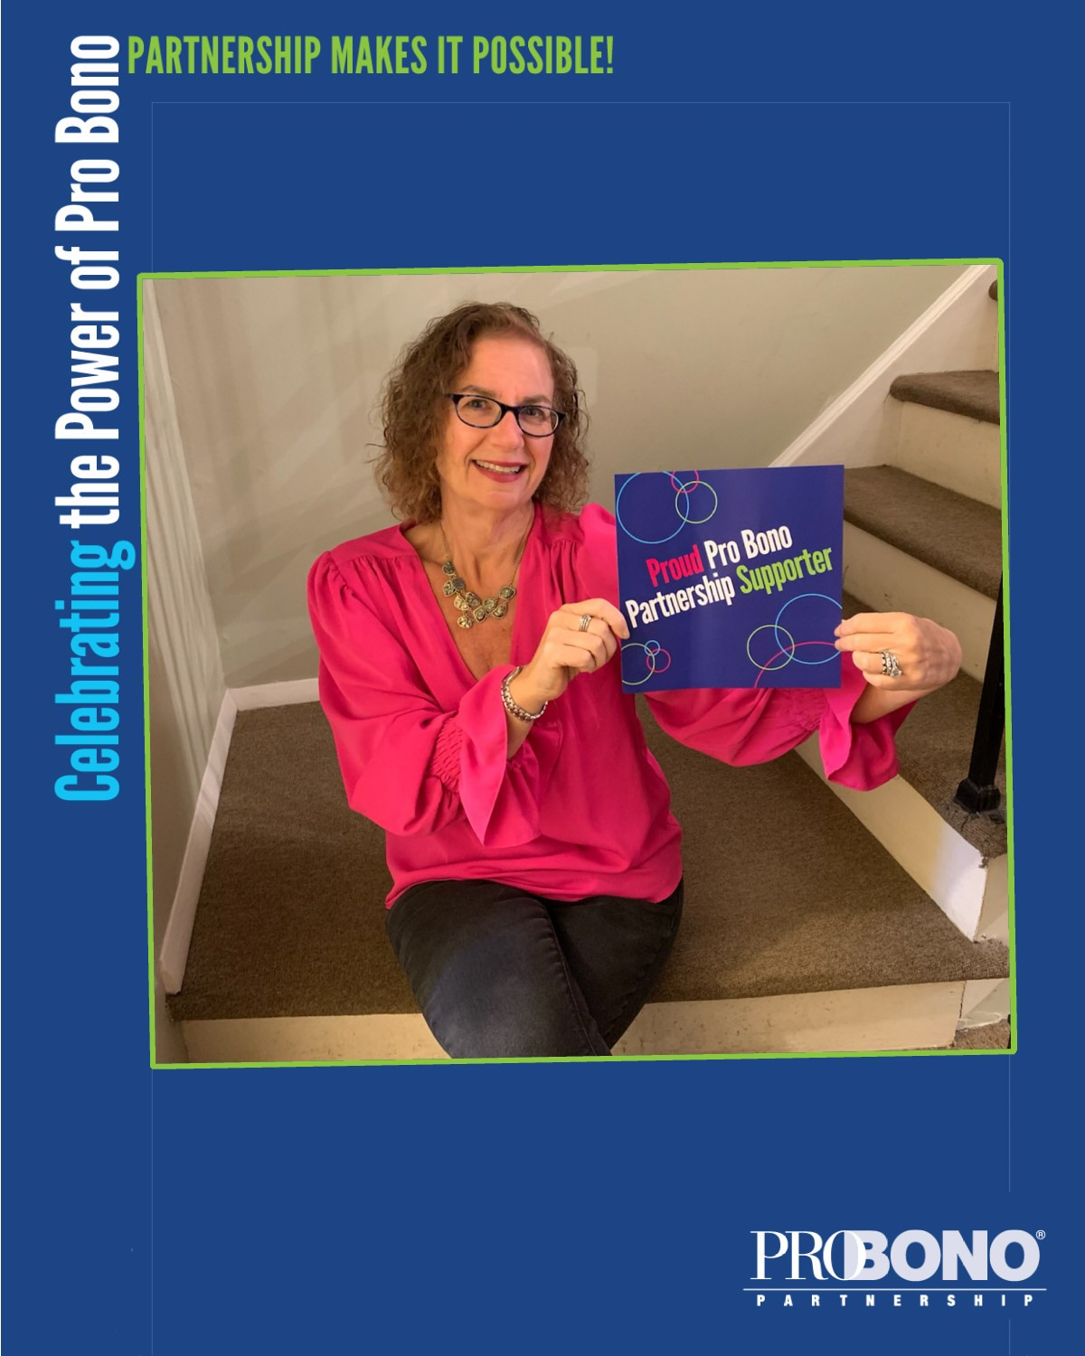
For More Information
Pro Bono Partnership
Fairfield County/NY office:
jsiegel@probonopartner.org

